Slide 1

Milestone 3- BBC News Classification Analysis
Sreenivasulu Somu
Bellevue University
DSC680-T301 Applied Data Science
Amirfarrokh Iranitalab

Slide 2

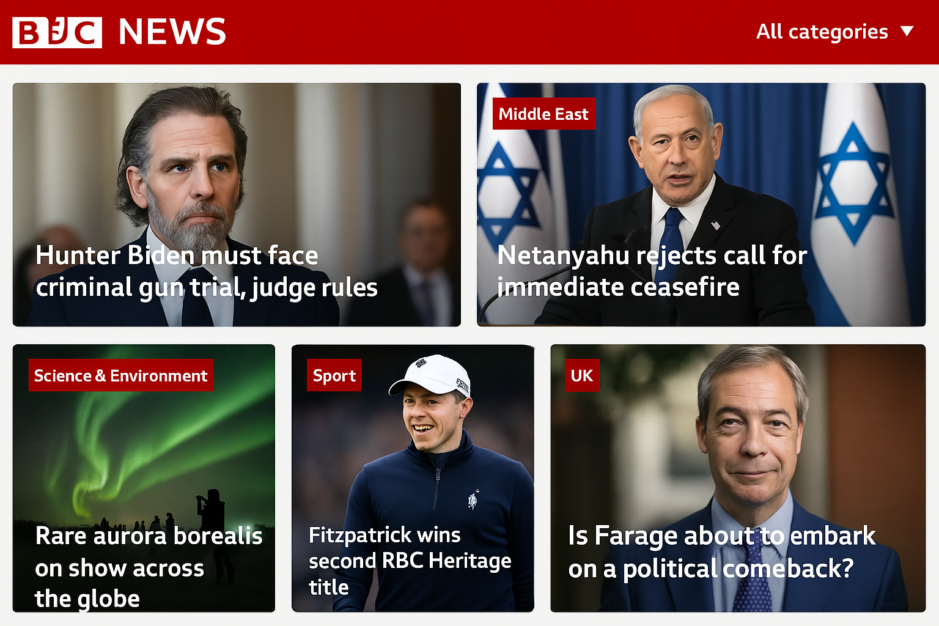
Business problem
The goal is to predict BBC news articles (News_length) into categories such as business, politics, sport, entertainment, and tech using Regression analysis.
Predict article length by category improves resource planning, content strategy, and platform optimization for better user experience and efficiency

Slide 3
Dataset explanation
ArticleId: Unique identifier for each article.
Text: Full text of the article.
Category: The label indicating the type of news (e.g., business, politics).
News_length: Number of characters in the article.
Text_parsed: Preprocessed version of the article text.
Category_target: Numerical encoding of the category (e.g., business = 0).

Slide 4
Regression Models Used
• Logistic Regression
• Naive Bayes
• Random Forest
• XGBoost
Text was vectorized using TF-IDF and split into training/testing sets.
Notes:
Term Frequency - Inverse Document Frequency (TF-IDF) is a widely used statistical method in natural language processing and information retrieval

Slide 5
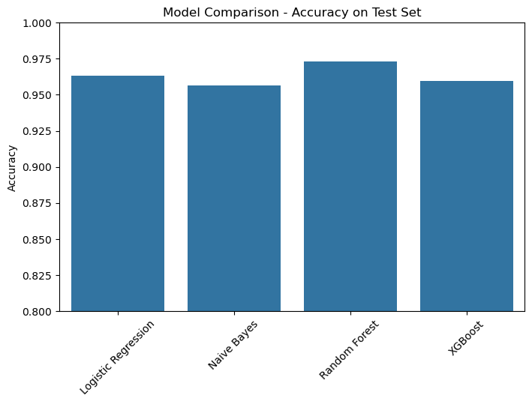
Model Evaluation
Random Forest has the highest accuracy at 97.32%, and its effectiveness in handling complex datasets and making precise predictions.
Logistic Regression achieved an accuracy of 96.31% with strong predictive performance in classifying data effectively and reliably.
XGBoost reached an accuracy of 95.97%, offering competitive results with robust performance, though marginally behind Random Forest in precision.
Naive Bayes achieved 95.64%, showing solid results but slightly lower precision compared to other models tested.
Model | Accuracy
Random Forest | 97.32%
Logistic Regression | 96.31%
XGBoost | 95.97%
Naive Bayes | 95.64%
Notes:
Accuracy Scores:
• Logistic Regression: ~96.3%
• Naive Bayes: ~95.6%
• Random Forest: ~97.3%
• XGBoost: ~95.9%

Slide 6
Conclusion
Random Forest is recommended for its strong accuracy and ability to handle imbalance.
It provides robust and reliable categorization suitable for real-time deployment.
Random Forest provides better consistency and minimizes misclassifications, that can be important for content personalization.

Slide 7
Ethical Assessment
Avoid bias in classification due to imbalanced datasets.
Ensure transparency in model predictions to maintain trustworthiness.
Protect user privacy by anonymizing sensitive information during data processing.

Slide 8
Questions
1. What is the main goal of this project?
2. Why is article classification important for BBC News?
3. What kind of data was used for this analysis?
4. How were the articles prepared before feeding into the models?
5. What models were used, and which one performed the best?
6. Why did Naive Bayes perform slightly worse than other models?
7. How does the imbalance in category frequency affect the results?
8. Could the same article belong to more than one category?
9. How can this system be used in real-time news classification?
10. What ethical concerns did you consider?

Slide 9
Assumptions & Limitations
Assumptions:
Text preprocessing (stemming, stop word removal) adequately captures semantic meaning.
TF-IDF effectively represents textual features.
Limitations:
Class imbalance may bias predictions toward majority categories.
Limited to 5 categories; may not generalize to new topics.
Random Forest’s "black-box" nature reduces interpretability

Slide 10
Thank you

